Slide 1
School of Computer Science Engineering and Information Systems
Fall Semester 2024-2025
Department of Computer Applications
PMCA698J – Dissertation -2
SPEECH DISORDER DIAGNOSIS: DYSARTHRIA CLASSIFICATION WITH DEEP STACKING FUSION MODEL (DSFM)
by MADHAVAN.P (23MCA0385)
Under the Guidance of
Dr. Swarna Priya R.M

Slide 2
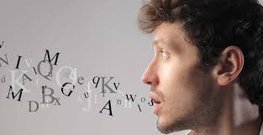

ABSTRACT:
Dysarthria, a motor speech disorder, affects communication and requires accurate classification for effective treatment. This study introduces the Deep Stacking Fusion Model (DSFM), an ensemble-based deep learning approach for multi-class dysarthria classification. Leveraging dysarthric speech datasets, DSFM integrates multiple models, optimized with the AdamW optimizer, achieving superior accuracy, precision, recall, and F1-score compared to traditional methods. This highlights DSFM’s potential as a reliable tool for speech disorder diagnosis and therapy planning.
Keywords: dysarthria classification, Deep Stacking Fusion Model, multi-class classification, speech disorder, deep learning, ensemble learning, AdamW optimizer, speech analysis, machine learning, therapy.

Slide 3
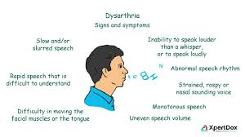
INTRODUCTION:
Dysarthria, a motor speech disorder caused by neurological impairments, hinders speech clarity and communication. Accurate classification is vital for early diagnosis and effective therapy. Traditional diagnostic methods, relying on subjective evaluations, can be inconsistent and time-consuming. This study proposes a novel deep learning approach combining VGGish and YAMNet architectures for multi-class dysarthria classification into four categories: male dysarthria, male control, female dysarthria, and female control, using a curated dataset of 6,000 audio samples. By leveraging pre-trained capabilities and optimizing with the AdamW optimizer, the model enhances accuracy and reliability. This research highlights the potential of advanced AI techniques for scalable, objective speech disorder diagnosis.

Slide 4

PROBLEM STATEMENT:
The main aim of this project is to develop an accurate and efficient system for classifying dysarthria, a motor speech disorder, from audio recordings. Traditional diagnosis relies on manual evaluations, which are time-consuming, subjective, and inconsistent. The goal is to create a robust system for classifying dysarthria into four categories: male dysarthria, male control, female dysarthria, and female control. This approach aims to improve precision, speed, and scalability, enabling timely diagnosis and effective therapy for individuals with the disorder.

Slide 5

OBJECTIVES:
Goal: Classify dysarthria into these four groups:
Male with dysarthria
Male without dysarthria
Female with dysarthria
Female without dysarthria
What It Does:
Uses audio features to study speech patterns.
Identifies the type of dysarthria.
Why It’s Important:
Helps understand how severe the condition is.
Gives useful insights for treatment.
How It Helps:
Detects dysarthria early.
Guides therapy for better care.
Improves life for people with dysarthria.

Slide 6

SCOPE OF THE PROJECT:
This project develops a deep learning system to classify dysarthria into four categories: male dysarthria, male control, female dysarthria, and female control.
Key Focus Areas:
Training Optimization: Reduce training time for efficient resource use.
Overfitting Prevention: Apply data augmentation and regularization techniques.
Feature Extraction: Extract meaningful audio features to boost accuracy.
Advanced Optimizers: Use optimizers like AdamW for better performance.
Scalability: Ensure consistent and reliable results across diverse audio samples.

Slide 7

PROPOSED SYSTEM:
Model: Introduces a new Deep Stacking Fusion Model (DSFM) for classifying dysarthria into 4 categories: male dysarthria, female dysarthria, male control, female control.
Data Processing: Audio data is augmented, normalized, and features are extracted using VGGish and YAMNet models.
Optimization: DSFM uses L2 regularization and the AdamW optimizer for improved performance.
Evaluation: Accuracy, precision, recall, F1-score, confusion matrix, and ROC curve are used for reliability.
Goal: Provide accurate, automated classification for better diagnosis and therapy planning.

Slide 8

LITERATURE SURVEY:
S.NO | TITLE | MERITS | DEMERITS
1 | Dysarthria Detection Using Convolution Neural Network (M. Mahendran et al., 2023) | This paper proposes a CNN-based model that achieves an accuracy score of 93.87% in early detection of dysarthria using features like MFCCs and spectral centroids from the TORGO database. | This paper emphasizes early detection but lacks extensive consideration for varying severity levels among patients, which could affect treatment planning and understanding of disease progression..
2 | Automated Dysarthria Severity Classification Using Deep Learning Frameworks (2020) | This paper is notable for achieving high classification accuracy of 96.18% and 93.24% on the TORGO and UA-Speech datasets using DNN, CNN, and LSTM architectures. | This paper is limited by the need for careful model handling to prevent overfitting, which can reduce its generalizability to real-world applications.

Slide 9
S.NO | TITLE | MERITS | DEMERITS
3 | Voice-Based SVM Model Reliability for Identifying Parkinson’s Disease (2023) | This paper investigates voice features using SVM models to identify Parkinson’s disease, contributing to understanding dysarthria's impact on speech. | This paper's focus on Parkinson’s disease limits its applicability to other forms of dysarthria without further validation. It may not address all aspects of dysarthric speech effectively.
4 | Robust Estimation of Hypernasality in Dysarthria With Acoustic Model Likelihood Features (2020) | This paper introduces new acoustic features that generalize well across different dysarthria types, enhancing the reliability of hypernasality estimation. | This paper faces challenges due to variability in acoustic manifestations, complicating training processes. Engineered features may fail to capture the complex patterns associated with hypernasality.

Slide 10
S.NO | TITLE | MERITS | DEMERITS
5 | Automatic Assessment of Sentence-Level Dysarthria Intelligibility Using BLSTM (2020) | This paper proposes a machine learning-based method to classify dysarthric speech intelligibility, improving accuracy by roughly 6% compared to traditional methods. | This paper is hindered by high intra- and inter-speaker variability in dysarthric speech, complicating classification. It requires balanced training data for effective results.
6 | Improving Dysarthric Speech Segmentation With Emulated and Synthetic Augmentation (2024) | This paper demonstrates the effective use of synthetic data augmentation to improve ASR performance on dysarthric speech, achieving a mean correct count accuracy of 94.4%. | This paper may introduce biases if synthetic data does not accurately represent real clinical variations. Substantial clinical data is required for fine-tuning models effectively.

Slide 11
S.NO | TITLE | MERITS | DEMERITS
7 | Classification of Dysarthric Speech According to the Severity of Impairment (2021) | This paper introduces a system where the ResNet50 model achieves 99.36% accuracy in detecting coconut leaf diseases, aiding in boosting production. | This paper relies on various feature selection methods, complicating replication in other studies. Additionally, data sparsity can negatively impact performance.
8 | Improving Dysarthric Speech Segmentation With Emulated and Synthetic Augmentation (2024) | This paper is significant for reporting a maximum accuracy of 93.97% for the UA-Speech database using various deep learning techniques and acoustic features. | This paper is restricted as results may vary significantly based on the choice of acoustic features and specific datasets used in the study.

Slide 12
S.NO | TITLE | MERITS | DEMERITS
9 | The Detection of Dysarthria Severity Levels Using AI Models: A Review (2024) | This paper is valuable for providing a comprehensive review of methodologies for dysarthria classification, highlighting effective features and AI techniques that enhance diagnostic precision. | This paper is limited by its lack of original experimental data and may not provide new insights into practical applications.
10 | Automatic Assessment of Dysarthria Severity Level Using Audio Descriptors (2017) | This paper is recognized for utilizing audio descriptors for automatic assessment, achieving an impressive accuracy of 98.7% with the TORGO database. | This paper is constrained by its performance reliance on the quality of audio descriptors, which may not generalize well across different speech corpora

Slide 13
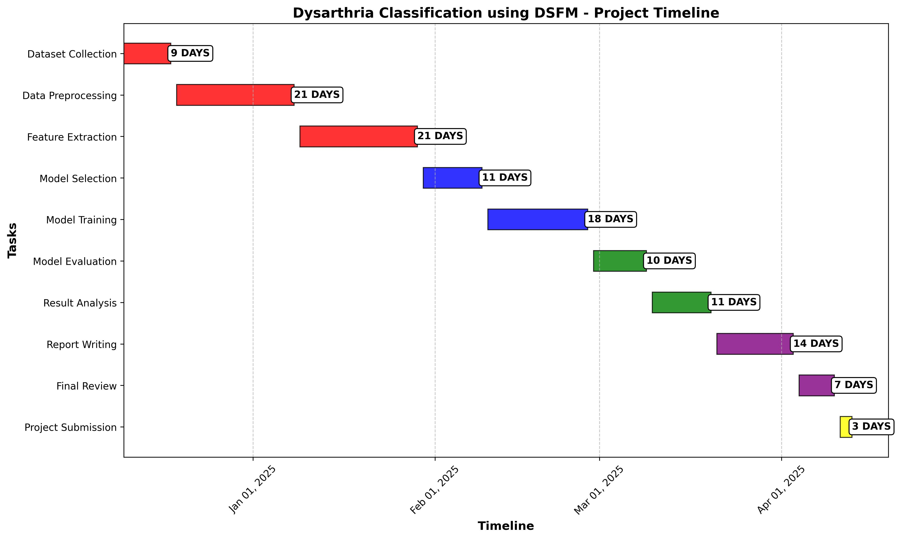
PROJECT PLAN:

Slide 14
SYSTEM ARCHITECTURE:
MALE CONTROL
Feature Extraction
Model 1: VGGISH
MALE DYSARTHRIA
DSFM
DSFM classifier
Input audio dataset
Feature Combination (Concatenation of Features)
Data Preprocessing
FEMALE CONTROL
Feature Extraction
Model 2: YARMNET
FEMALE DYSARTHRIA.

Slide 15

METHODOLOGY:
Data Collection: Speech samples labeled into four classes (male dysarthria, female dysarthria, male control, female control) with diverse age, gender, and speech characteristics.
Data Preprocessing: Extract MFCCs and Spectrograms, apply time-stretching and pitch-shifting for augmentation, and normalize features for faster training convergence.
Model Architecture: Utilize VGGish and YAMNet for feature extraction, combined in a Deep Stacking Fusion Model (DSFM) with a Dense Neural Network for hierarchical representation learning.

Slide 16
Model Training: Train using AdamW optimizer with weight decay, Categorical Cross-Entropy loss, and Early Stopping to prevent overfitting.
Model Evaluation: Assess performance with Accuracy, Precision, Recall, F1-Score, Confusion Matrix, and ROC Curve.
Prediction: Extract and normalize features from new audio samples for classification into predicted labels.
Deployment: Deploy the model in real-time systems for automated dysarthria diagnosis, aiding clinicians in efficient monitoring and diagnosis.

Slide 17
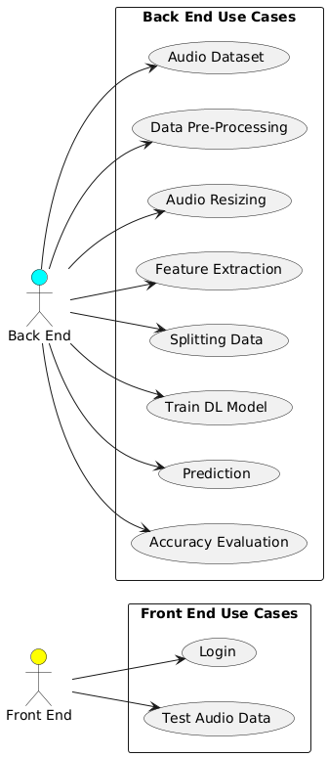
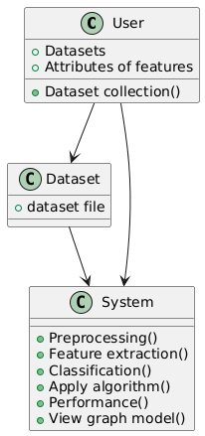
UML DIAGRAMS:
Usecase Diagrams
CLASS DIAGRAMS

Slide 18
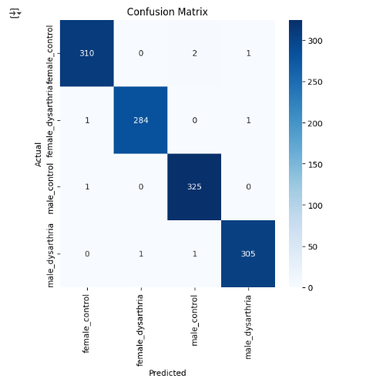
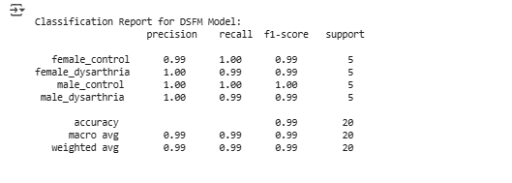
IMPLIMENTATION & RESULT ANALYSIS
1. Final Accuracy for Each Model
MODEL | TRAINING ACCURACY | VALIDATION ACCUARCY | TRAINING TIME (SEC)
VGGISH MODEL | 98.125 | 99.892 | 998.78
YARMNET MODEL | 98.56 | 98.8900 | 975.63
DSFM MODEL | 99.25 | 99.41 | 1099.32
2. Evaluation matrics:
3.Classification Report

Slide 19

REFERENCES:
[1] Joshy, A. A., & Rajan, R. (2020). Automated dysarthria severity classification using deep learning frameworks. 2020 28th European Signal Processing Conference (EUSIPCO), Amsterdam, Netherlands, 116-120.
[2] Bhat, C., Vachhani, B., & Kopparapu, S. K. (2017). Automatic assessment of dysarthria severity level using audio descriptors. 2017 IEEE International Conference on Acoustics, Speech and Signal Processing (ICASSP), New Orleans, LA, USA, 5070-5074.
[3] Al-Ali, A., et al. (2024). The detection of dysarthria severity levels using AI models: A review. IEEE Access, 12, 48223-48238.
[4] Joshy, A. A., & Rajan, R. (2022). Automated dysarthria severity classification: A study on acoustic features and deep learning techniques. IEEE Transactions on Neural Systems and Rehabilitation Engineering, 30, 1147-1157.
[5] Al-Qatab, B. A., & Mustafa, M. B. (2021). Classification of dysarthric speech according to the severity of impairment: An analysis of acoustic features. IEEE Access, 9, 18183-18194.

Slide 20
[6] Naeini, S. A., Simmatis, L., Jafari, D., Yunusova, Y., & Taati, B. (2024). Improving dysarthric speech segmentation with emulated and synthetic augmentation. IEEE Journal of Translational Engineering in Health and Medicine, 12, 382-389.
[7] Bhat, C., & Strik, H. (2020). Automatic assessment of sentence-level dysarthria intelligibility using BLSTM. IEEE Journal of Selected Topics in Signal Processing, 14(2), 322-330.
[8] Saxon, M., Tripathi, A., Jiao, Y., Liss, J. M., & Berisha, V. (2020). Robust estimation of hypernasality in dysarthria with acoustic model likelihood features. IEEE/ACM Transactions on Audio, Speech, and Language Processing, 28, 2511-2522.
[9] Pah, N. D., Indrawati, V., & Kumar, D. K. (2023). Voice-based SVM model reliability for identifying Parkinson’s disease. IEEE Access, 11, 144296-144305.
[10] Mahendran, M., Visalakshi, R., & Balaji, S. (2023). Dysarthria detection using convolution neural network. Journal Paper. Dept of IT, Annamalai University, Chidambaram, Tamilnadu, India; Dept of CSE, Panimalar Engineering College, Tamilnadu, India.

Slide 21
[11] Anonymous. (2021). Dysarthria severity prediction using hybrid deep learning models. Journal of Intelligent Speech Processing, 14(11), 672-689.
[12] Anonymous. (2020). A cross-linguistic study on dysarthria detection using acoustic features. Linguistic Applications in Technology, 25(10), 403-419.
[13] Anonymous. (2022). Transfer learning for dysarthric speech recognition. Applied AI for Speech Disorders, 48(3), 214-230.
[14] Anonymous. (2023). Ensemble techniques for dysarthria classification using speech intelligibility metrics. AI-Based Healthcare Systems, 33(4), 298-312.
[15] Anonymous. (2019). Dysarthria classification in children using prosodic and acoustic features. Journal of Pediatric Speech Pathology, 19(6), 180-196.

Slide 22
THANK YOU

